Slide 1
Recommendation for Berlin
FOR EVERYONE WHO WANTS TO HAVE A MIRCLE IN BERLIN

Slide 2
Introduction
Berlin is the one of the very trendy cities. Berlin has been rapidly changing a lot because many people are coming for leaving and working. Hence various resaurants are openining and closing. my purpose of the data analysis is to help people's business.

Slide 3
Problem
Many people can possibly think that once they open a restaurant with very fancy and tasty food in Berlin, wherever it opens, it would be a success. but the problem is that in Berlin, there are already too many competitors on even one kind of food. Personally, I already saw some people struggling to find a proper solution or information to start with their business. but people tend to rely on the some information in internet, which is not reliable.

Slide 4
Objective
Hence I would like to help people's business to avoid the worst scenario. Because once people starts with a own business, probably they might need to spend the cost to setup the restaurant.Therefore , I'm going to design the recommendation data analysis by using the Foursqure data and clustering technique,ML, And Based on the data, I'm going to recommend the best spot for their business. Kreuzberg is currently quite trendy and popular town in Berlin for people to enjoy various cultures like foods. Therefore I'm going to focus on this town to start with this project.

Slide 5
target audience
Even though this project is desigined for only people who want to open a restaurant in Kreuzberg of Berlin, Actually this approach way can be applied to anywhere

Slide 6
Data
There are two big categories for the data, which are location data and venue data from Foursquare. these data will be utilized for the data analaysis when to recommend the places for users who who want to find out the nice places for their businesses.
Berlin post codes, geo-location information (latitude, longitude) : basically, the data includes geo location information of all berlin areas as well as post code information. https://data.technologiestiftung-berlin.de/dataset/plz/en
Berlin traffic information : this data-set provides traffic information per street. https://data.technologiestiftung-berlin.de/dataset/verkehrsmengen/en
Berlin map based on postcode information (to narrow down the range ) : actually the data is not utilized on the real code, however it is referred to narrow down the data range(area) https://www.interkart.de/en/wall-maps/europe/germany/city-maps/berlin-postcode-area-map.html
Berlin Kreuzberg map information to check http://zip-code.en.mapawi.com/germany/10/kreisfreie-stadt-berlin/2/141/berlin-kreuzberg/10961/1330/
Foursquare venue information ( via API ) https://developer.foursquare.com/docs/api/venues/details

Slide 7
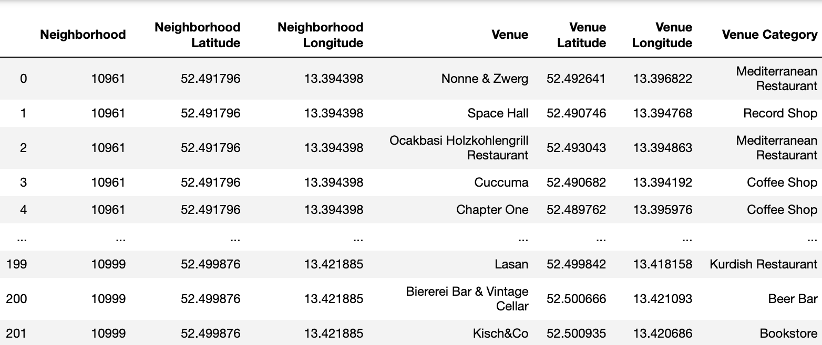
Data – venues in Berlin, Kreuzberg

Slide 8
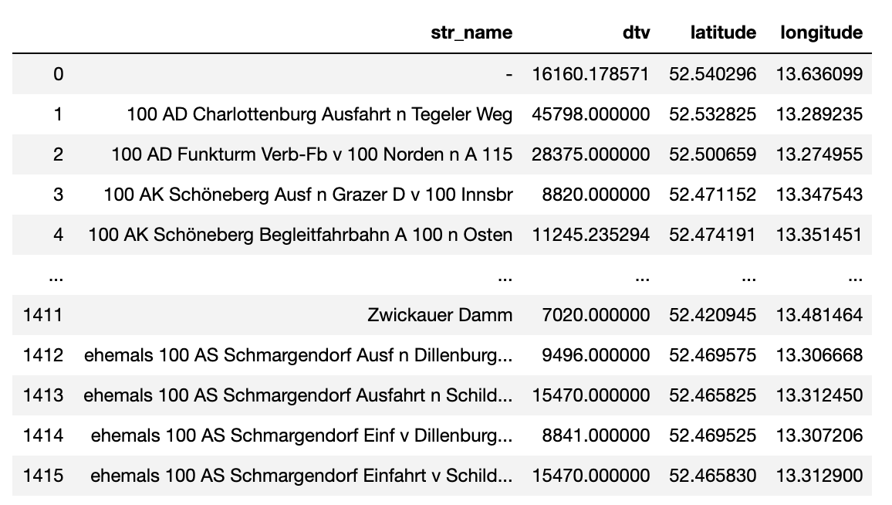
Data – traffic information in Berlin

Slide 9
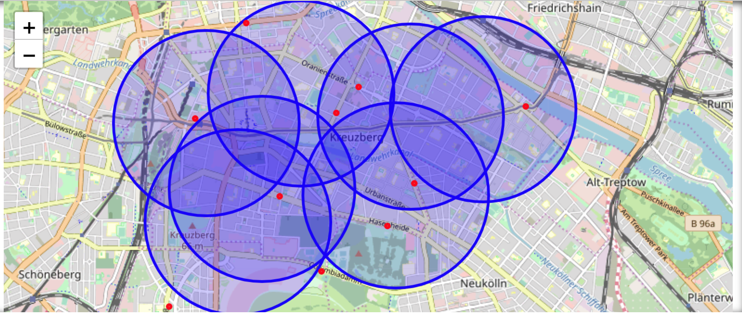
Analaysis 1 – postcode base clusters

Slide 10
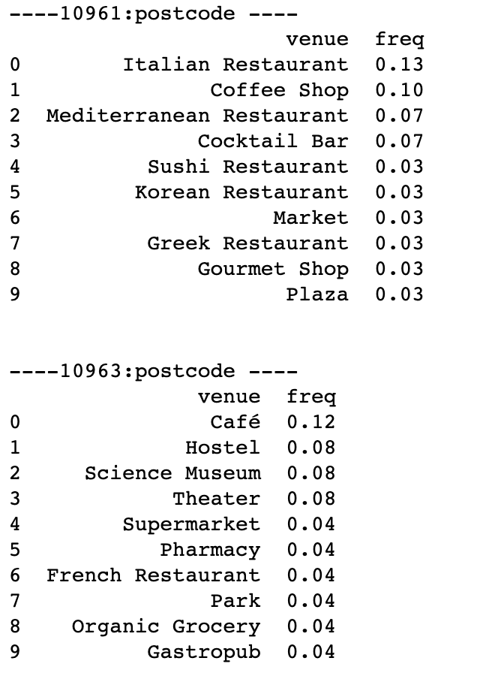
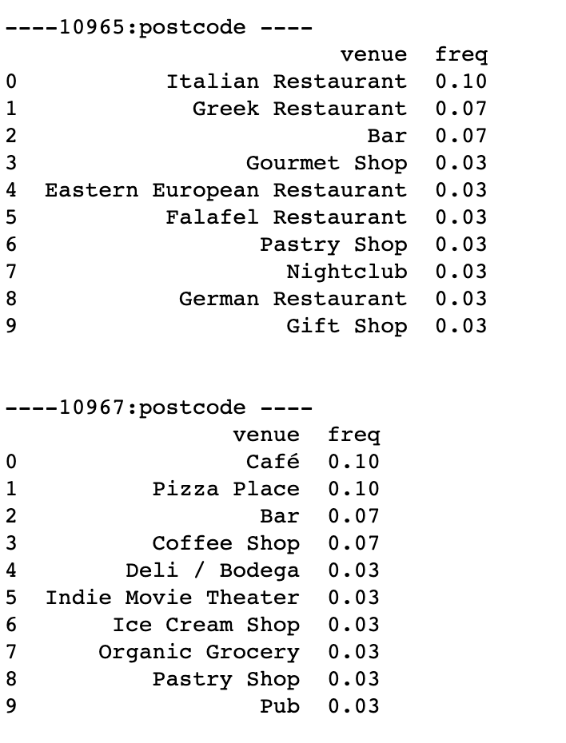
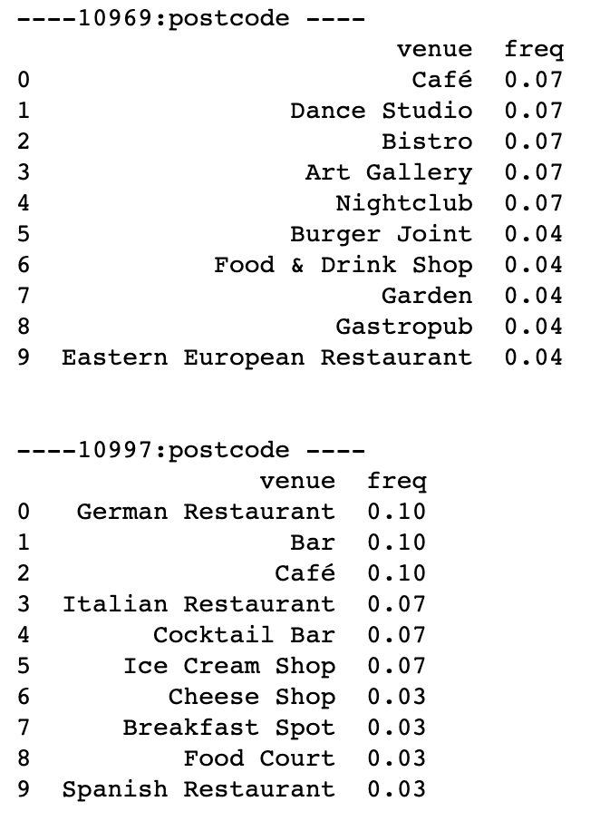
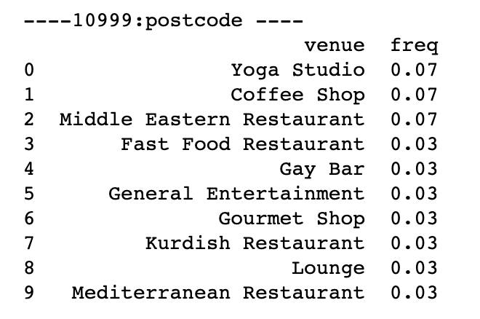
Analysis 2 – venue frequency

Slide 11
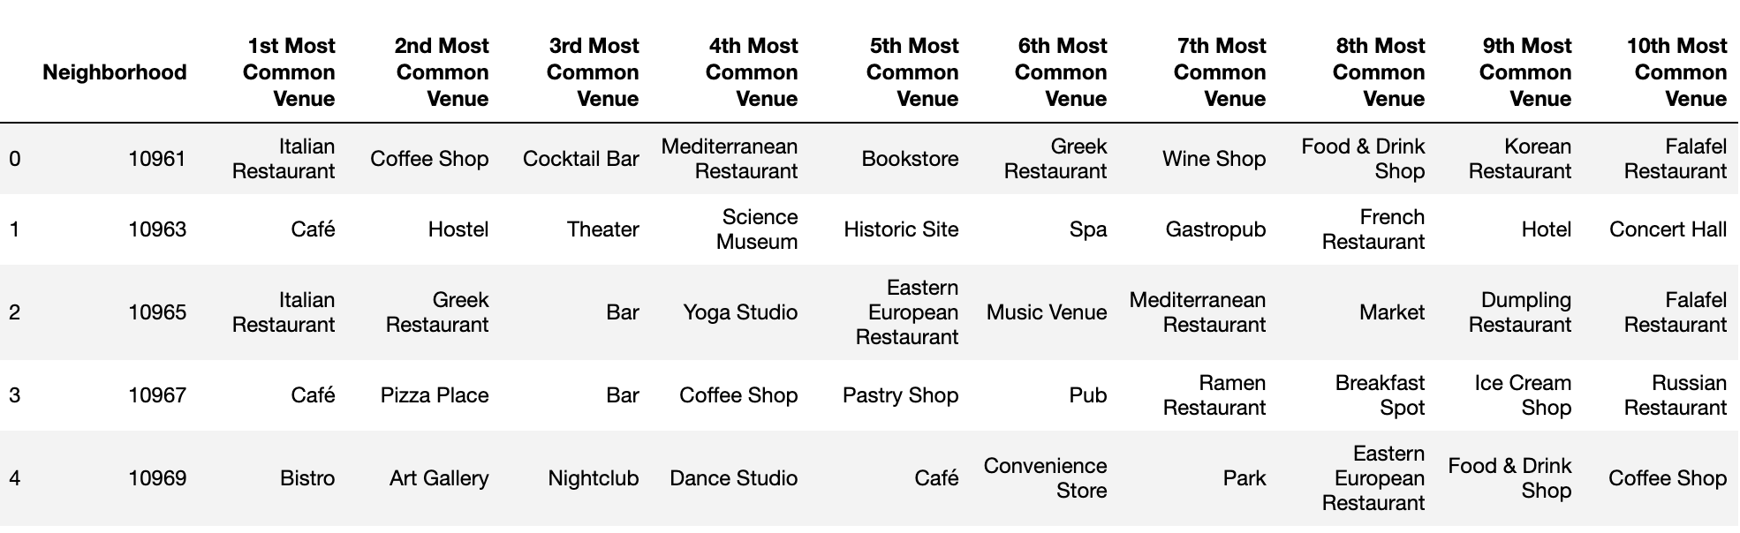
Analaysis 3 – most common venue

Slide 12
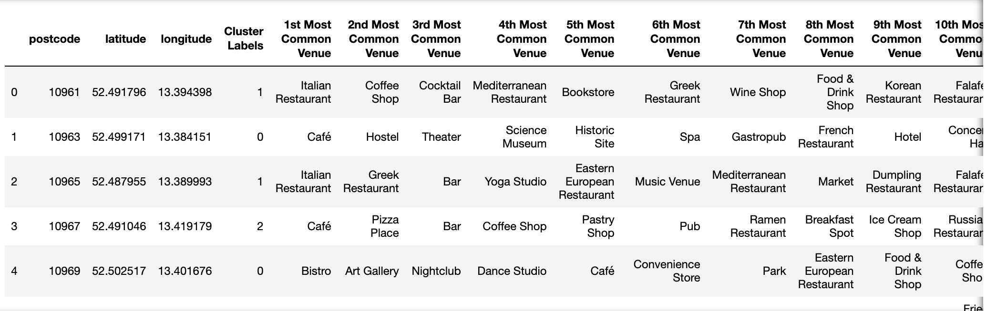
Analysis 4 – Clustering and mapping

Slide 13
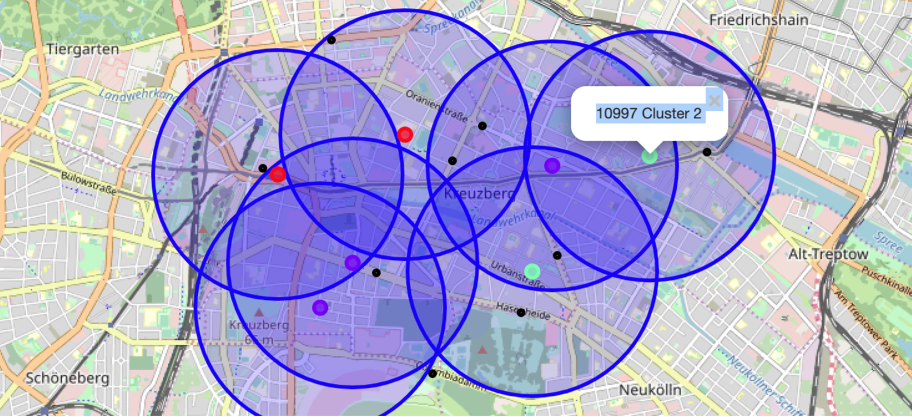
Analysis 5 – Clustering and presentation

Slide 14
Result
Through the K-means cluster technique, I can see that there 5 major areas on the Kreuzberg, berlin to suggest the nice places. As you can see the map, you can figure out that the red cluster, which is located in west-north area, Mostly, there are many cafes and bistros. Also, In the red cluster zone, we can figure out that there are historic sites , hostels, art galleries and theaters compared to other area(cluster).
On the first cluster((post code 10965 - 10999), Mostly there are many nice Italian Restaurants and yoga places. On the second clusters(post code 10967 - 10997), which are located in east of Kreuzberg, there are many cafes and german restaurants.
Overall, there are many cafes and bars over the all areas. famous places mostly are located in west area.
According to the traffic information(black color points on the map), there are huge traffic volume around U-bahn(subway)stations such as Mockernbrucke, Kottbusser Tor, Schonleinstrasse and Gneisenaustrasse. On the cluster 0, there are almost 20000 ~ 40000 daily traffic amount which are the highest among the clusters. because there are famous venues on the area

Slide 15
Conclusion
If people have to find a nice place to open a new restaurant in Kreuzberg, Berlin. people have to consider major 3 factors as below.
1) How close is it to U-bahn station
2) How many restaurants are already opened on the area on a certain category that you want
3) Why do people visit the area
As I reviewd the data on the discussion, Over the area of Kreuzberg, there are already so many cafes and bars as well as restaurants. Once we look at the west-north area of map, there are some famous sites like historical builings. Hence it would be great to open a shop or restaurant which is very helpful for tourlists. they might want to use the shop on a certain purpose very fast to save the time. people here might have the tendency to move quickly and to be tourlists.
When it comes to the center area (cluster 1), even though many people go through the area, there are not many sport clubs and culture-oriented buildings.In this area, it would be great to open a shop or restaurant for the potential consumers who want more healthy food and complex business that has a food shop and sport club.
In conclusion, In the cluster 0(red), it would be great to open a shop or restaurant by the very unique and necessary stuffs for the tourlists. In the cluster 1(purple), it would be great to open a shop or restaurant that can provide very healthy foods that people who like sports would love to. In the cluster 2(light green), there are already many fancy restaurants which are german. Hence it would be great to open a shop or restaurant that provide the different international foods.

